Slide 1
Virtualization
Virtualization is a process that allows a computer to share its hardware resources with multiple digitally separated environments. Each virtualized environment runs within its allocated resources, such as memory, processing power, and storage.

Slide 2
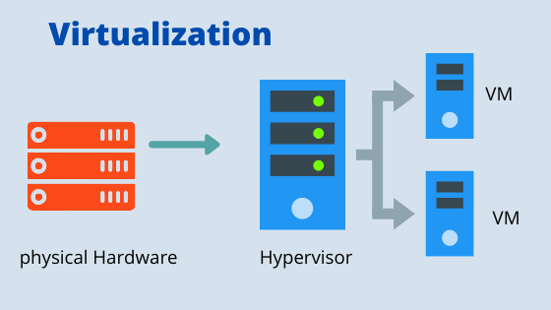

Slide 3
Hypervisor
A hypervisor is a software that you can use to run multiple virtual machines on a single physical machine.

Slide 4
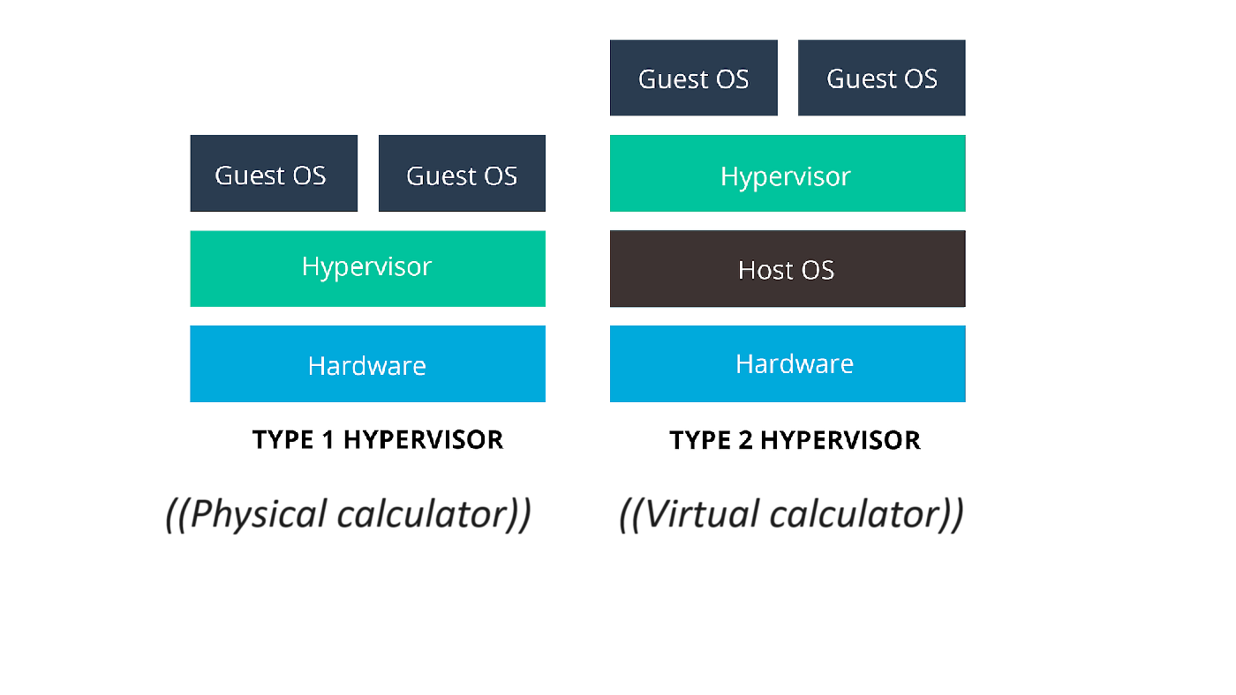

Slide 5
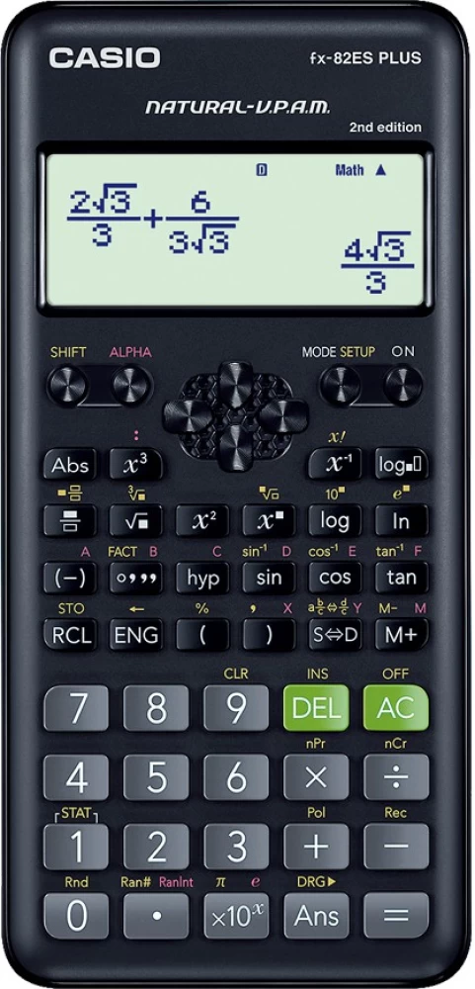

Slide 6
